Slide 1
ASSIGNMENT 3
WORKING WITH ALGORITHMS
Oluwanifemi OYEWOLE

Slide 2
Pseudocode for Quadratic Equation
INPUT A
INPUT B
INPUT C
COMPUTE X1 =[(B^2)+(B – {4}*{A}*{C})^(1/2)] / (2 * A)
COMPUTE X2 =[(B^2) - (B – {4}*{A}*{C})^(1/2)] / (2 * A)
PRINT X1
PRINT X2

Slide 3

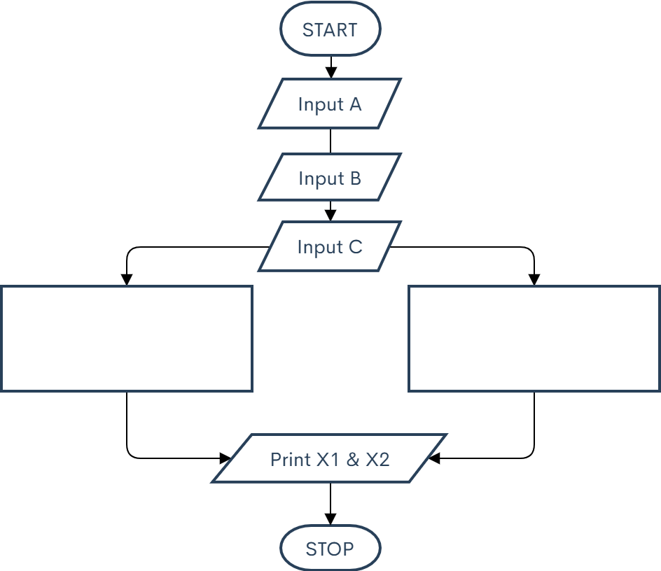


Flowchart for Quadratic Equation
$$x_{1}=\frac{−b−\sqrt{b^{2}−4ac}}{2a}$$
$$x_{2}=\frac{−b+\sqrt{b^{2}−4ac}}{2a}$$

Slide 4

Pseudocode for Quadratic Equation: $x^{2}−5x+2=0$
INPUT A
INPUT B
INPUT C
COMPUTE X1 =[(-5^2)+(-5 – {4}*{1}*{2})^(1/2)] / (2 * 1)]
COMPUTE X2 =[(-5^2)+(-5 – {4}*{1}*{2})^(1/2)] / (2 * 1)]
PRINT X1
PRINT X2

Slide 5
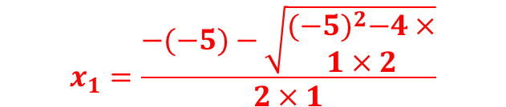
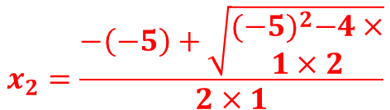
Flowchart for Quadratic Equation
$$x_{1}=\frac{−(−5)−\sqrt{\begin{aligned}{(−5)}^{2}−4× \\ 1×2\end{aligned}}}{2×1}$$
$$x_{2}=\frac{−\left(−5\right)+\sqrt{\begin{aligned}{(−5)}^{2}−4× \\ 1×2\end{aligned}}}{2×1}$$

Slide 6
